Slide 1
Name: Abdullah sadakat ali
Roll no: 2k24-bsse-132

Slide 2

Project 1: wedding card

Slide 3
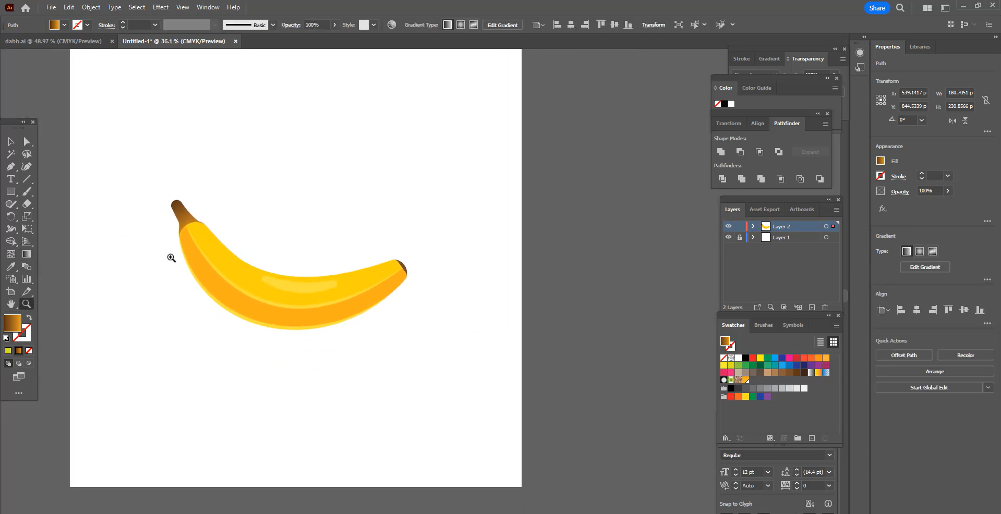
Project 2: Adobe illustrator design

Slide 4

Project 3: pencil tool

Slide 5


